Slide 1

Semiannual Meeting February 24, 2023 10:00 to 11:30 am

Slide 2
Zoom Info
Via Zoom:
https://us06web.zoom.us/j/87258079102
Meeting ID: 872 5807 9102
One tap mobile
+13462487799, 87258079102# US (Houston)
+16694449171, 87258079102# US

Slide 3
Agenda & Introductions
Welcome & Introductions Patrick Alexander
Resident Council Update Patrick Alexander
Opening Remarks Mary Linde
Community Updates
Marketing Jeff Brenner
COVID-19 Hanh Ta
Strategic Plan Mary Linde
2023 Budget
Intro to budget process Mary Linde
Budget detail Jon Casey
Questions All

Slide 4
Resident Council Update – Patrick Alexander
2023 Officers:
Patrick Alexander, President
Martha Torres, Vice President
Paula Cornyn, Treasurer
Theo Armour, Secretary
Food Committee Update

Slide 5
Opening Remarks – Mary Linde
Semiannual Meeting:
Required by the Contract Statutes
“Free discussion of subjects including, but not limited to, income, expenditures, and financial trends and issues as they apply to the continuing care retirement community and proposed changes in policies, programs, and services.”
January: Budget process/new budget approved by BOD
August: Review of audited financials/investment portfolio
Our Fiscal Year is the same as the Calendar Year – January to December.

Slide 6
Community Updates
Marketing: Jeff Brenner
COVID-19: Hanh Ta
Strategic Plan: Mary Linde

Slide 7
Marketing Updates - Jeff Brenner
Morgan Renovation/Refresh Updates
Apartment Renovation Updates
New Phones/McGinley TV/Website changes
General Marketing Updates

Slide 8
Covid Updates - Hanh Ta
Covid-19 protocols will remain in place as part of the Infection Control Program
We will continue to wear face masks as a healthcare and congregate living community
Thank you for your ongoing support and collaboration to keep our community healthy and safe

Slide 9
Strategic Plan Updates - Mary Linde
Land Use Permit
SNF closure
Aging In Place
FAQ has been updated and is on the website: http://heritageonthemarina.org/heritage-repositioning/

Slide 10
Budget Process – Mary Linde
Residents are part of our budget process throughout the year:
Resident Financial Review Board (FRB): meets quarterly with administration to review the quarterly financials and variance report
Quarterly Variance Report is posted on Resident BB in lower level
Resident Council Survey is done to understand Resident priorities for the upcoming budget
Monthly Resident Council meetings
Complaints/issues brought up throughout the year
Resident Satisfaction Surveys

Slide 11
Budget Process
Formation:
Revenue projections
Wage/Staffing projections
Departmental Expense projections
Capital Expense projections
Ancillary Charge changes
Ideal Outcome: Revenue > Expenses = Contribution to cash reserves
Our Reality: Expenses > Revenue = Portfolio supplements operations

Slide 12
2023 Budget Review – Jon Casey
High level snapshot (budget 2022 to budget 2023):
Revenue decreased by $984k
Primarily HC/SNF revenue in anticipation of closure
Expenses decreased by $990K
HC/SNF closure; but some offset by RCFE/AIP expenses
FTEs overall will reduce
SNF closure
Morrison front of House
Projected operating loss $5.6M
Capital budget is $2.4M
Monthly fee increase for all contract types is 6.5%
Staff Increase is based on merit with range between 0% and 5%

Slide 13
Historical Increases and Information
HotM Five Year Monthly Fee Increase History:
2019: 4%
2020: 4%
2021: 4%
2022: 5%
2023: 6.5%
Nearby Life Plan Communities Comparison, 2023:
Front Porch (SFT): 9.5%
Sequoia Senior Living: 9.25%
Channing House: 8%
Heritage on the Marina: 6.5%
Other Information
2023 National MMI Increase Average 5.33%
2022 Consumer Price Index 6.4% (down from 7.1%)
2022 California Inflation stayed about 7%
2022 Unemployment 3.5%
MMI Increase Source: Ziegler CFO HotlineSM (September, 2022)
CPI and Unemployment Source: Bureau of Labor Statistics (www.bls.gov) (December, 2022) The unemployment statistic represents one data point in the overall
labor picture.

Slide 14
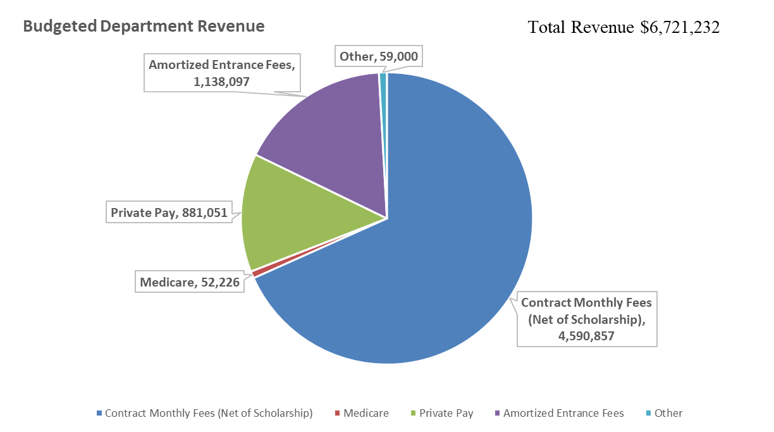

2023 Budget Review - Revenue

Slide 15
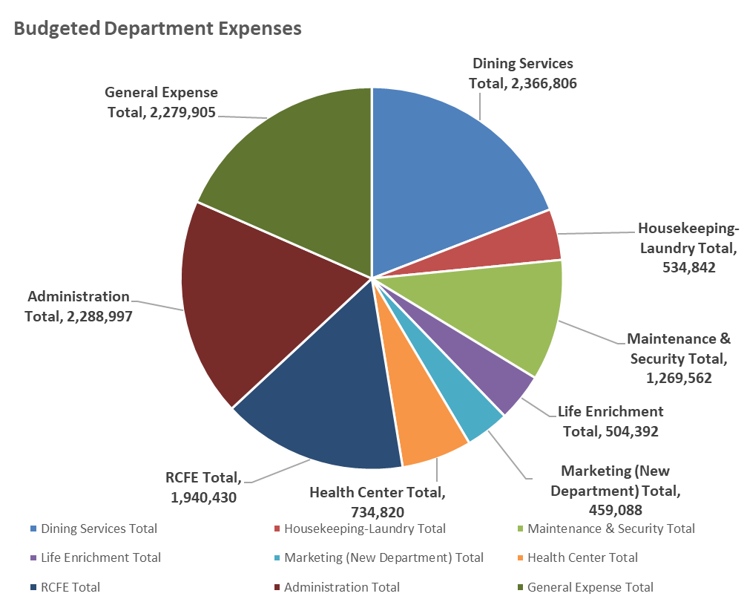
2023 Budget Review - Expenses
Total budgeted expenses: $12,378,842

Slide 16
2023 Capital Budget
Total budget approved: $2,413,727
Administration and HR
AV - Zoom Cart
General Contingency Funds
Staff Training Room
Marketing
Apartment Turnovers
Apartment Refreshes
Community Refreshes
Nursing
Nurse Call Relocation and Replace, RCFE Monitor
RCFE Equipment needs

Slide 17
2023 Capital Budget (Cont’d)
Maintenance
Morgan Elevator Access and Cab Refresh
Fire Alarm Audible Testing
Backflow Installation at Cottage Irrigation and Fire Protection Backflow
Backflow Installation at Morgan Domestic Water
Water Treatment for closed loop heating
Corner Landscaping at Laguna and Bay
Garden Irrigation and masonry work
Fire Alarm Door Hold-Open Devices Morgan South Stair
Boiler Plant redesign - Perry and Morgan
CCTV/Door Hardware
Sign Kiosks compliant with electronic health record (EHR)

Slide 18

Questions

